Slide 1
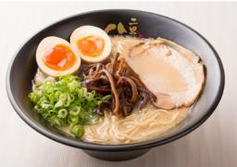
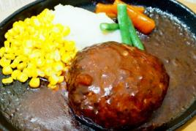
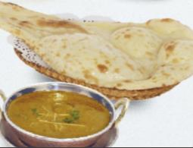
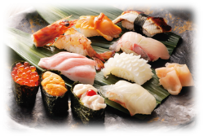

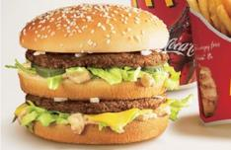
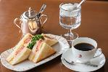

Lunchtime Choices for Participants of 2025 SA Meetings in Hakata
© 2024 ILCC Co., Ltd.

Slide 2
Restaurants and convenience stores around the venue in Hakata
This list gives you 334 choices of restaurants, convenience stores, supermarkets and lunchbox (Bento) shops around the venue
< About this list>
All the 334 restaurants and shops are classified by the type of cuisine and shop, and shown by icons with a picture to help you find your choice
After enabling PowerPoint file editing, double click the icon of your choice, you will find a list of shops or restaurants of that category
Then, if you choose (tap) one of the restaurants or shops in the list, you will have its detail information such as the URL and route map
You can use the Filter function to sort out your choice from other options such as the location, walking distance or walking time
Japanese foods … (page 3)
  Ramen, Tonkatsu, Tempura, Sushi, Teppanyaki, Yakiniku, Japanese Curry, Udon noodle, Soba, Okonomiyaki, Set meal menu
  Japanese cuisine, Seafood, Grilled Eel, Chicken skewer, Izakaya, Shabu-shabu/ Sukiyaki, Hot pot, Onigiri, Beef bowl, Takoyaki
  Fried skewers, Grilled beef tongue, Other Japanese food
World’s Cuisines … (page 4)
  Chinese cuisine, Taiwan cuisine, Korean cuisine, Indian/Nepali cuisine, Thai cuisine, Vietnamese cuisine, French cuisine
  Italian cuisine, Pasta, Spanish cuisine, Mexican food, Steak, Oyster bar, PUB/ Beer restaurant, Buffet, Hamburg steak, Omelet, Western food
Vegetarian (Restaurants with Vegetarian menu), Fast Food, Café/ Sweets, Family Restaurant, Take-out … (page 5)
< NOTES >
Use of delivery services (such as Uber Eats) are prohibited at the venue by the instruction of the public health department
Though, lunch pack bought by yourselves at a convenience store/supermarket is allowed to bring in the premise
Updated on Oct.29, 2024

Slide 3
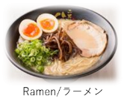
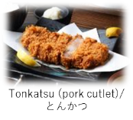
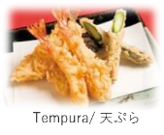
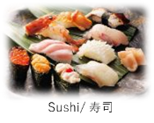
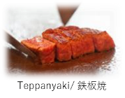
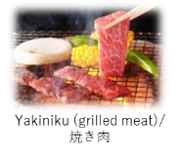
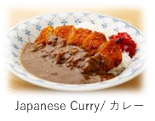
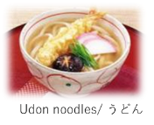
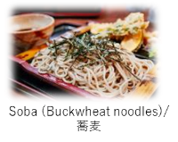
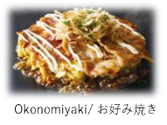
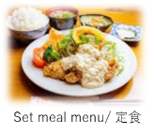
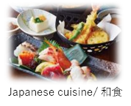
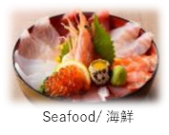
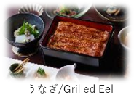
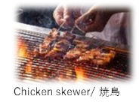
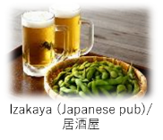
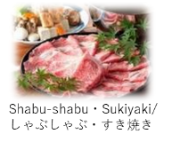
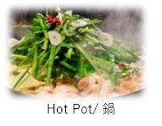
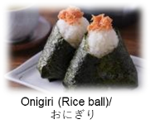
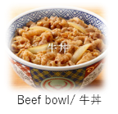
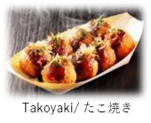
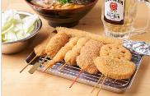
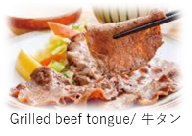
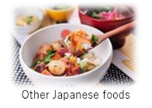
Please double click the below picture to go to your favorite restaurant
Japanese Food / 日本食
Fried skewers/ 串揚げ
Updated on Oct.29, 2024

Slide 4
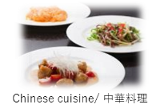
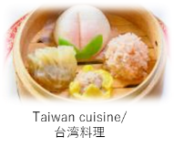
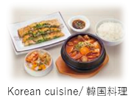
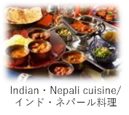
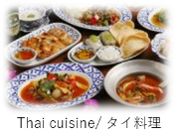
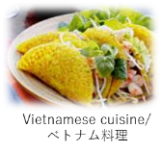
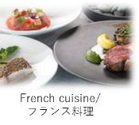
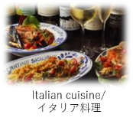
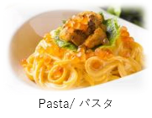
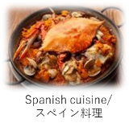
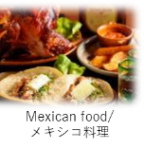
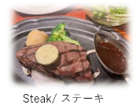
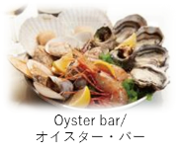
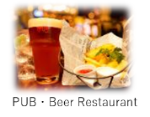
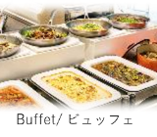
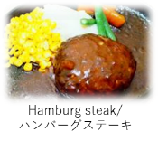

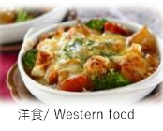
Please double click the below picture to go to your favorite restaurant
World’s Cuisines / 世界の料理
Updated on Oct.29, 2024

Slide 5
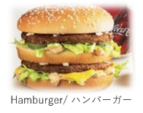
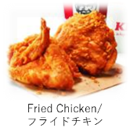

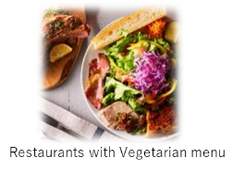








Please double click the below picture to go to your favorite restaurant
Restaurants with Vegetarian menu/ ベジタリアン メニューのあるレストラン
Fast Food / ファストフード
Café・Sweets / カフェ・スイーツ
Take out / テークアウト
Family restaurant / ファミレス
Updated on Oct.29, 2024

